Slide 1

ACCOUNT MANAGERS SALES PERFORMANCE
REPORT
REPORT
Presented by Riaz

Slide 2
Contents
Introduction
Data Insights
Analysis
Live Interactive Report
Recommendations

Slide 3
Business Task
Understand the Sales report of the company for past 3 years.
Analyse and check the performance of Account Managers of the company.

Slide 4
Data source and cleaning
Source:
https://www.kaggle.com/datasets/rajneesh231/retail-insights-a-comprehensive-sales-dataset
Cleaning:
Changed some data formats
Handled NULL values
Modified State column
Recalculated Revenue and Profit columns
Calculated a field of shipping days

Slide 5


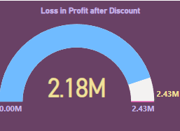
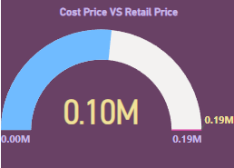
KEY METRICS

Slide 6
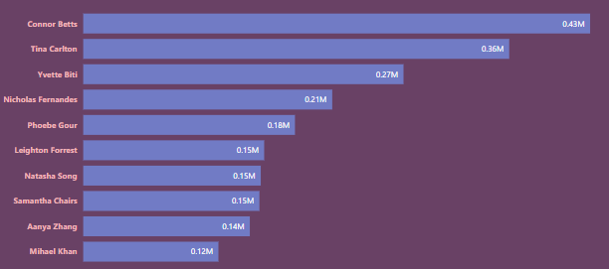
TOP 10 MANAGERS BY PROFIT
Insight #1
Connor Betts has given the highest number of profits to the company

Slide 7
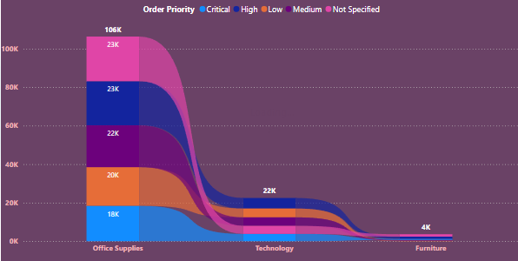
QUANTITY BY PRODUCT CATEGORY AND ORDER PRIORITY
Insight #2
Office supplies has the highest demand
Furniture has the lowest demand
On an average High priority category products has highest demand

Slide 8
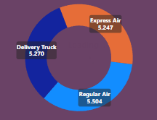
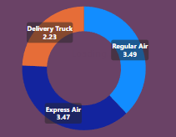
SHIPPING MODE
Insight #3
Express Air has the lowest shipping cost
Delivery truck takes the lowest time to ship

Slide 9
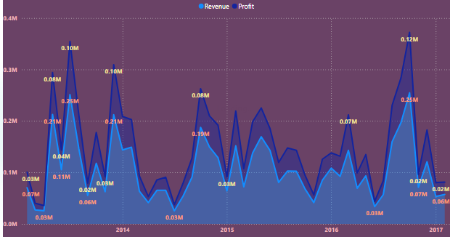
REVENUE VS PROFIT
Insight #4
Profit is exponentially dependent on Revenue
Sales hasn’t grown much
There is an increase in Sales during the time of summers

Slide 10
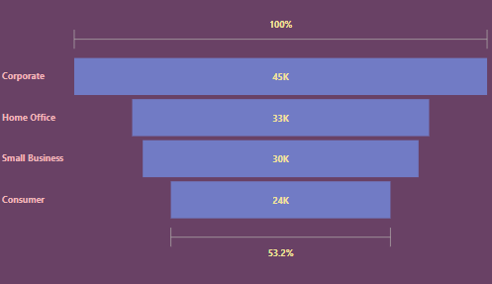
QUANTITY BY CUSTOMER TYPE
Insight #5
Corporate has the highest demand
Whereas Consumer with lowest demand

Slide 11
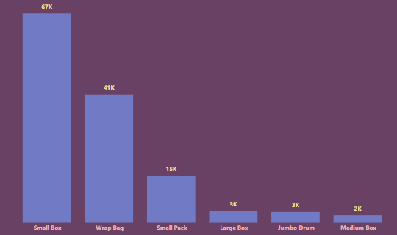
QUANTITY BY PRODUCT CONTAINER
Insight #6
Maximum products pack in small box
Large or medium size boxes has lowest frequency

Slide 12
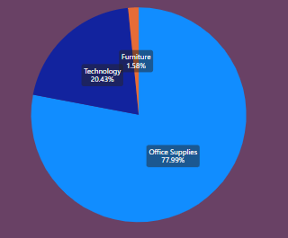
DISCOUNT BY PRODUCT CATEGORY
Insight #7
Office supplies has been given maximum discount

Slide 13
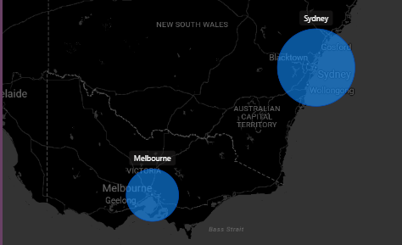
REVENUE BY CITY
Insight #8
Sydney and Melbourne has highest Sales

Slide 14
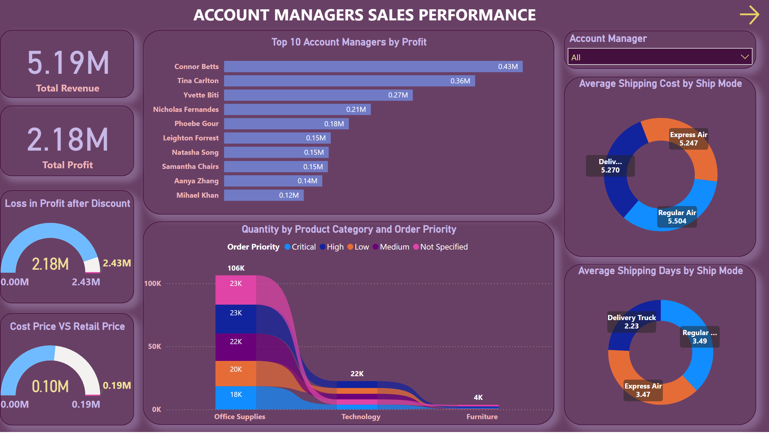
LIVE INTERACTIVE DASHBOARD

Slide 15
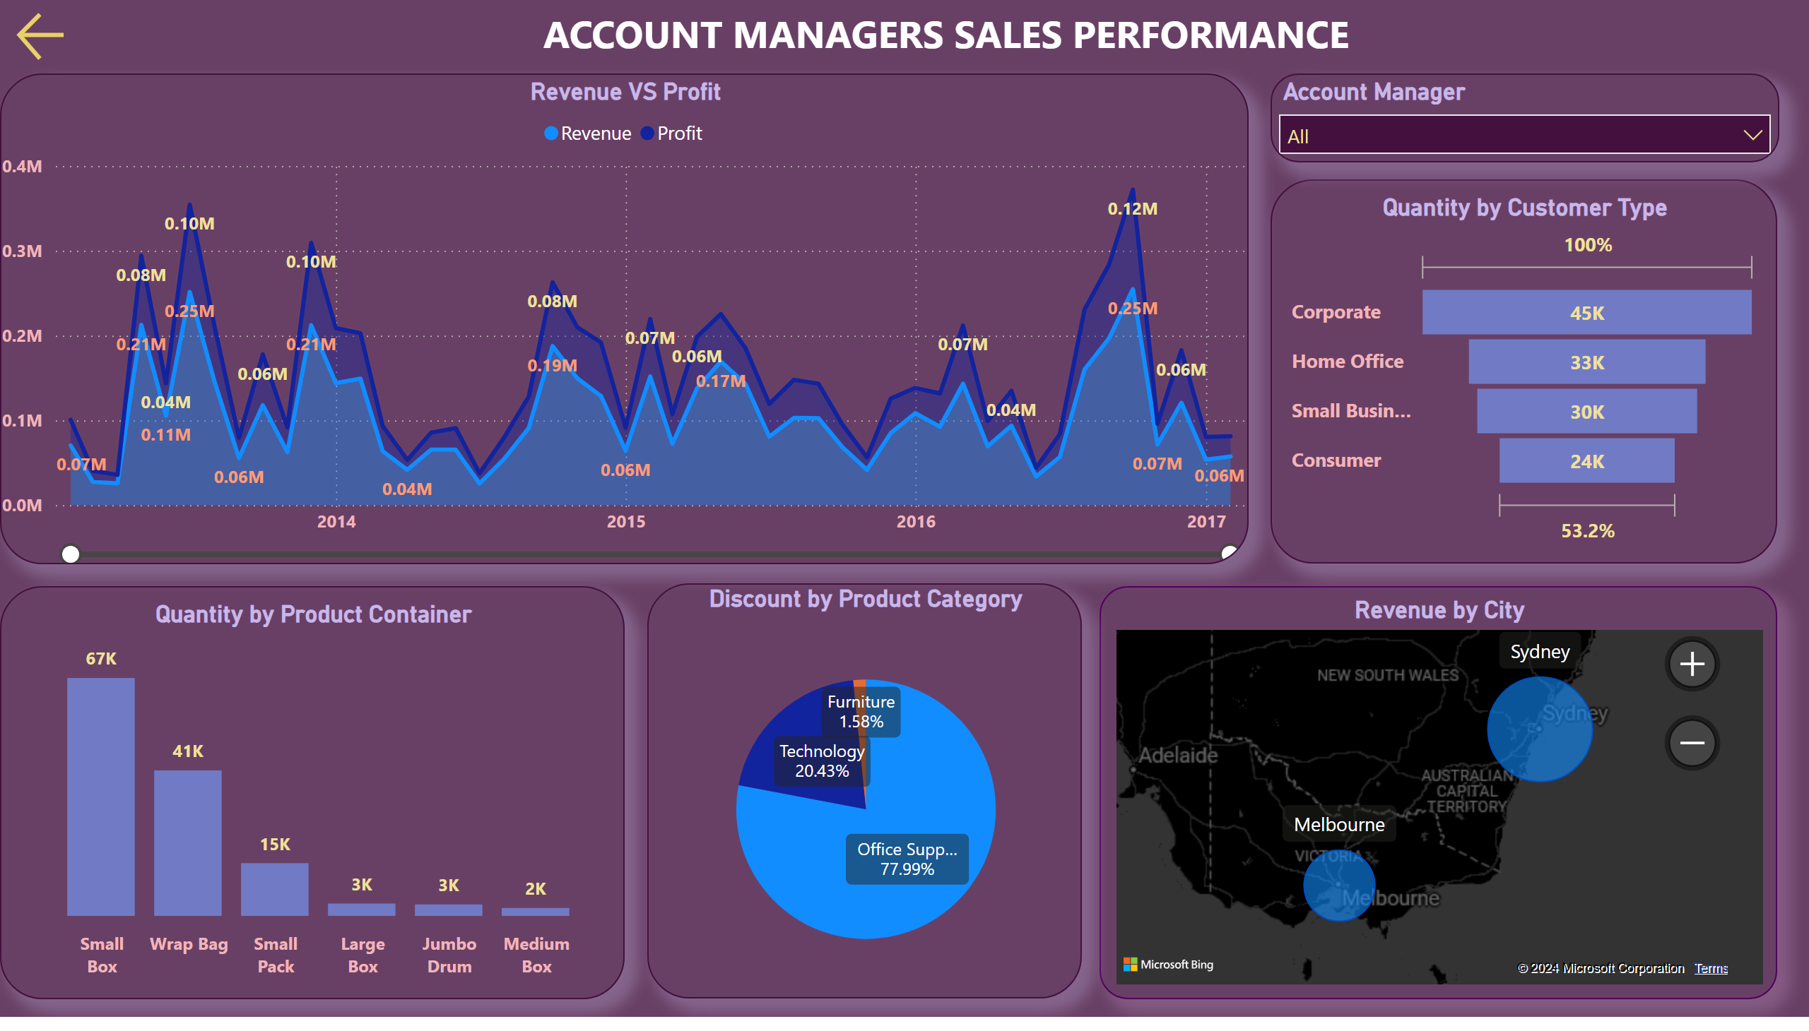
Page 1
LIVE INTERACTIVE DASHBOARD
Notes:
Top 10 Account Managers by Profit
No alt text provided
textbox
No alt text provided
actionButton
No alt text provided
Quantity by Product Category and Order Priority
No alt text provided
card
No alt text provided
Loss in Profit after Discount
No alt text provided
Cost Price VS Retail Price
No alt text provided
card
No alt text provided
Average Shipping Days by Ship Mode
No alt text provided
slicer
No alt text provided
Average Shipping Cost by Ship Mode
No alt text provided

Slide 16
RECOMMENDATIONS
Connor Betts, Tina Carlton and Yvette Biti must be given an appreciation with some benefits to enhance the company’s growth
Delivery trucks should be more promoted for shipping
Production of Office Supplies should increase
Products with small packaging must be promoted
Discount on Office Supplies must be decreased to increase the profits
Stores and sales should be promoted in the cities of Sydney and Melbourne

Slide 17

THANK YOU
Riaz
riazuddin4244@gmail.com

